Slide 1

Github intro
Illustrations by allison horst
Slides by hackmit via julia

Slide 2
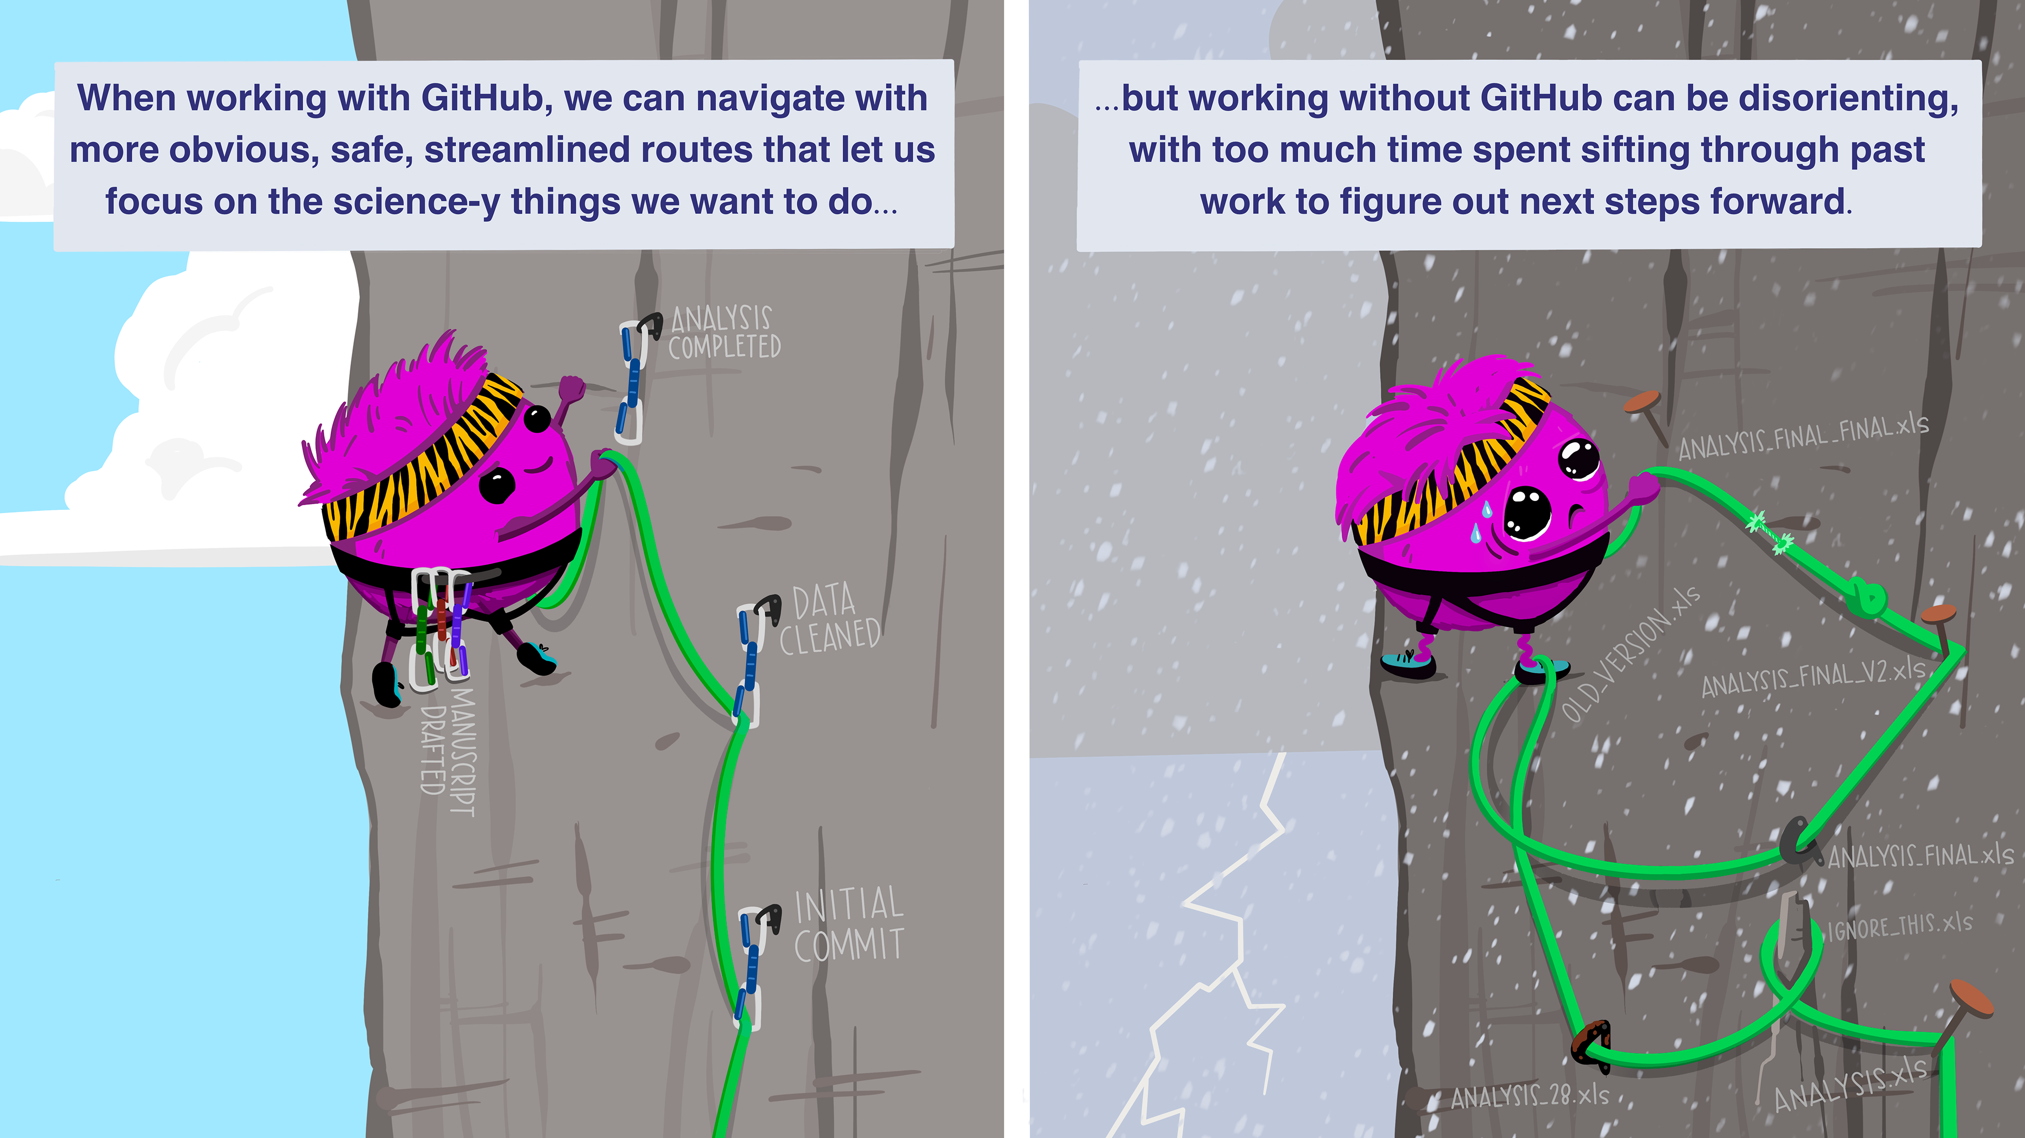
Why version control?

Slide 3
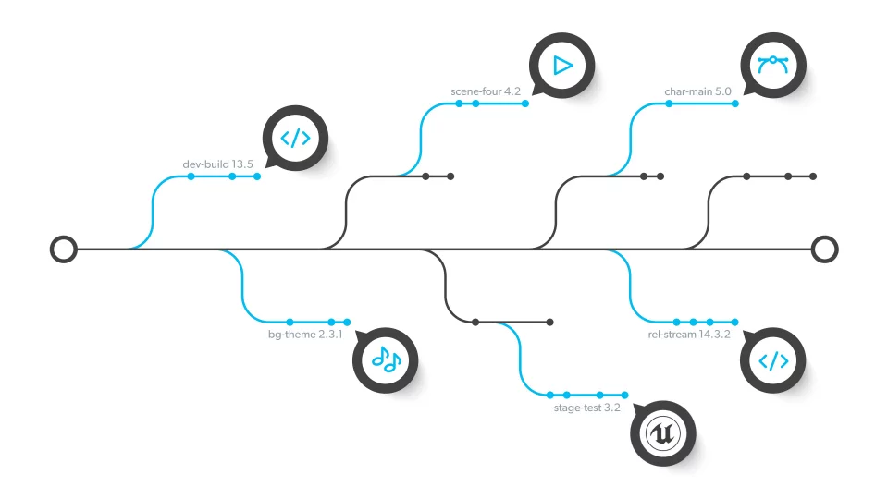
What is version control?
A system that keeps records of your changes
(Think Google Drive history but for your code)
Allows for collaborative development
Allows you to know who made what changes, when, and why
Can revert any change and go back to a previous state

Slide 4

What is git?
A type of distributed version control
Users keep entire code and history on their local machines
Can make changes without internet access
(Need internet to interact with remote server)

Slide 5

What is GitHub?
A code hosting platform for git
Basically a way to store your code on the internet to aid collaboration
Think Google Drive

Slide 6
Install git
Linux (Debian)
Command: sudo apt-get install git
Linux (Fedora)
Command: sudo yum install git
Mac
http://git-scm.com/download/mac
Windows
http://git-scm.com/download/win

Slide 7
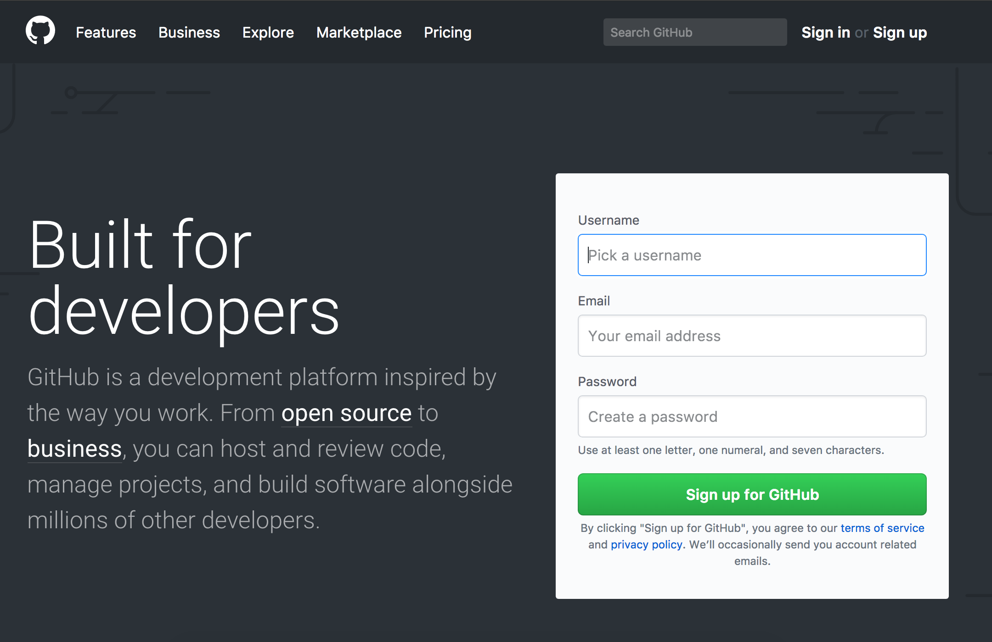
Create a GitHub account
https://www.github.com

Slide 8
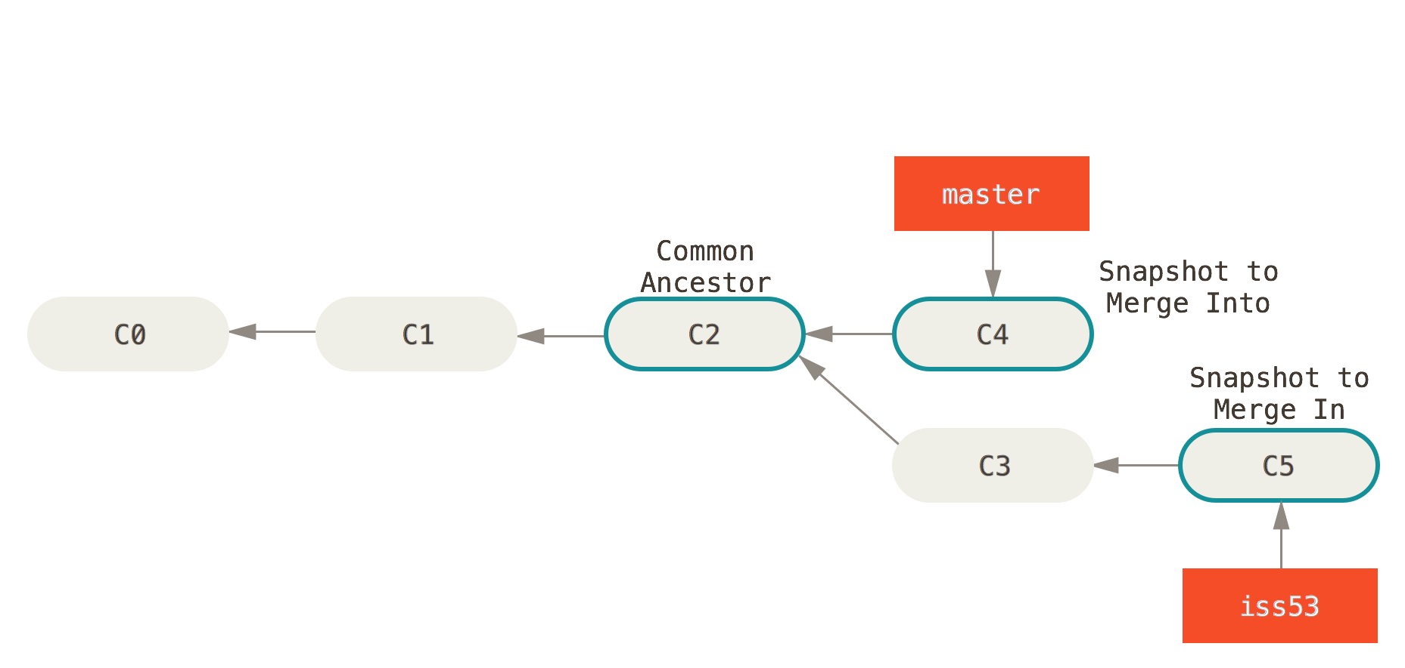
Key Concept: Snapshots
How git keeps track of code history
Records what all files look like at a given point in time
You choose when to take snapshot and which files are included
Can go back to look at old snapshots

Slide 9
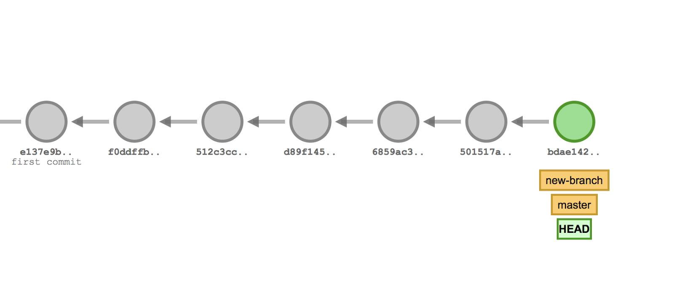
Key Concept: Commit
The act of creating a snapshot
Noun or verb
“I commited code”
“Take a look at the latest commit”
Project is made up of a bunch of commits
Have info about how files changed, reference to parent commit, and a hash code name

Slide 10
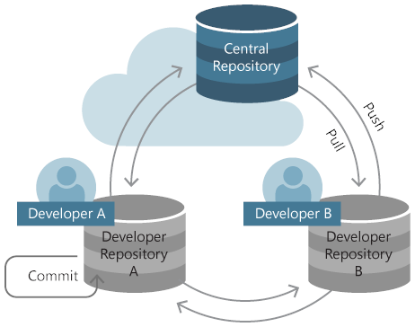
Key Concept: Repository
Often shortened to repo
Collection of files and the history of those files
Consists of all your commits
Can live on local machine or remote server (GitHub!)
Copying a repository from a remote server to your machine is called cloning
Allows teams to work together
Pulling: the process of downloading commits that don’t exist on your machine
Pushing: the process of adding your local changes to the remote repository

Slide 11
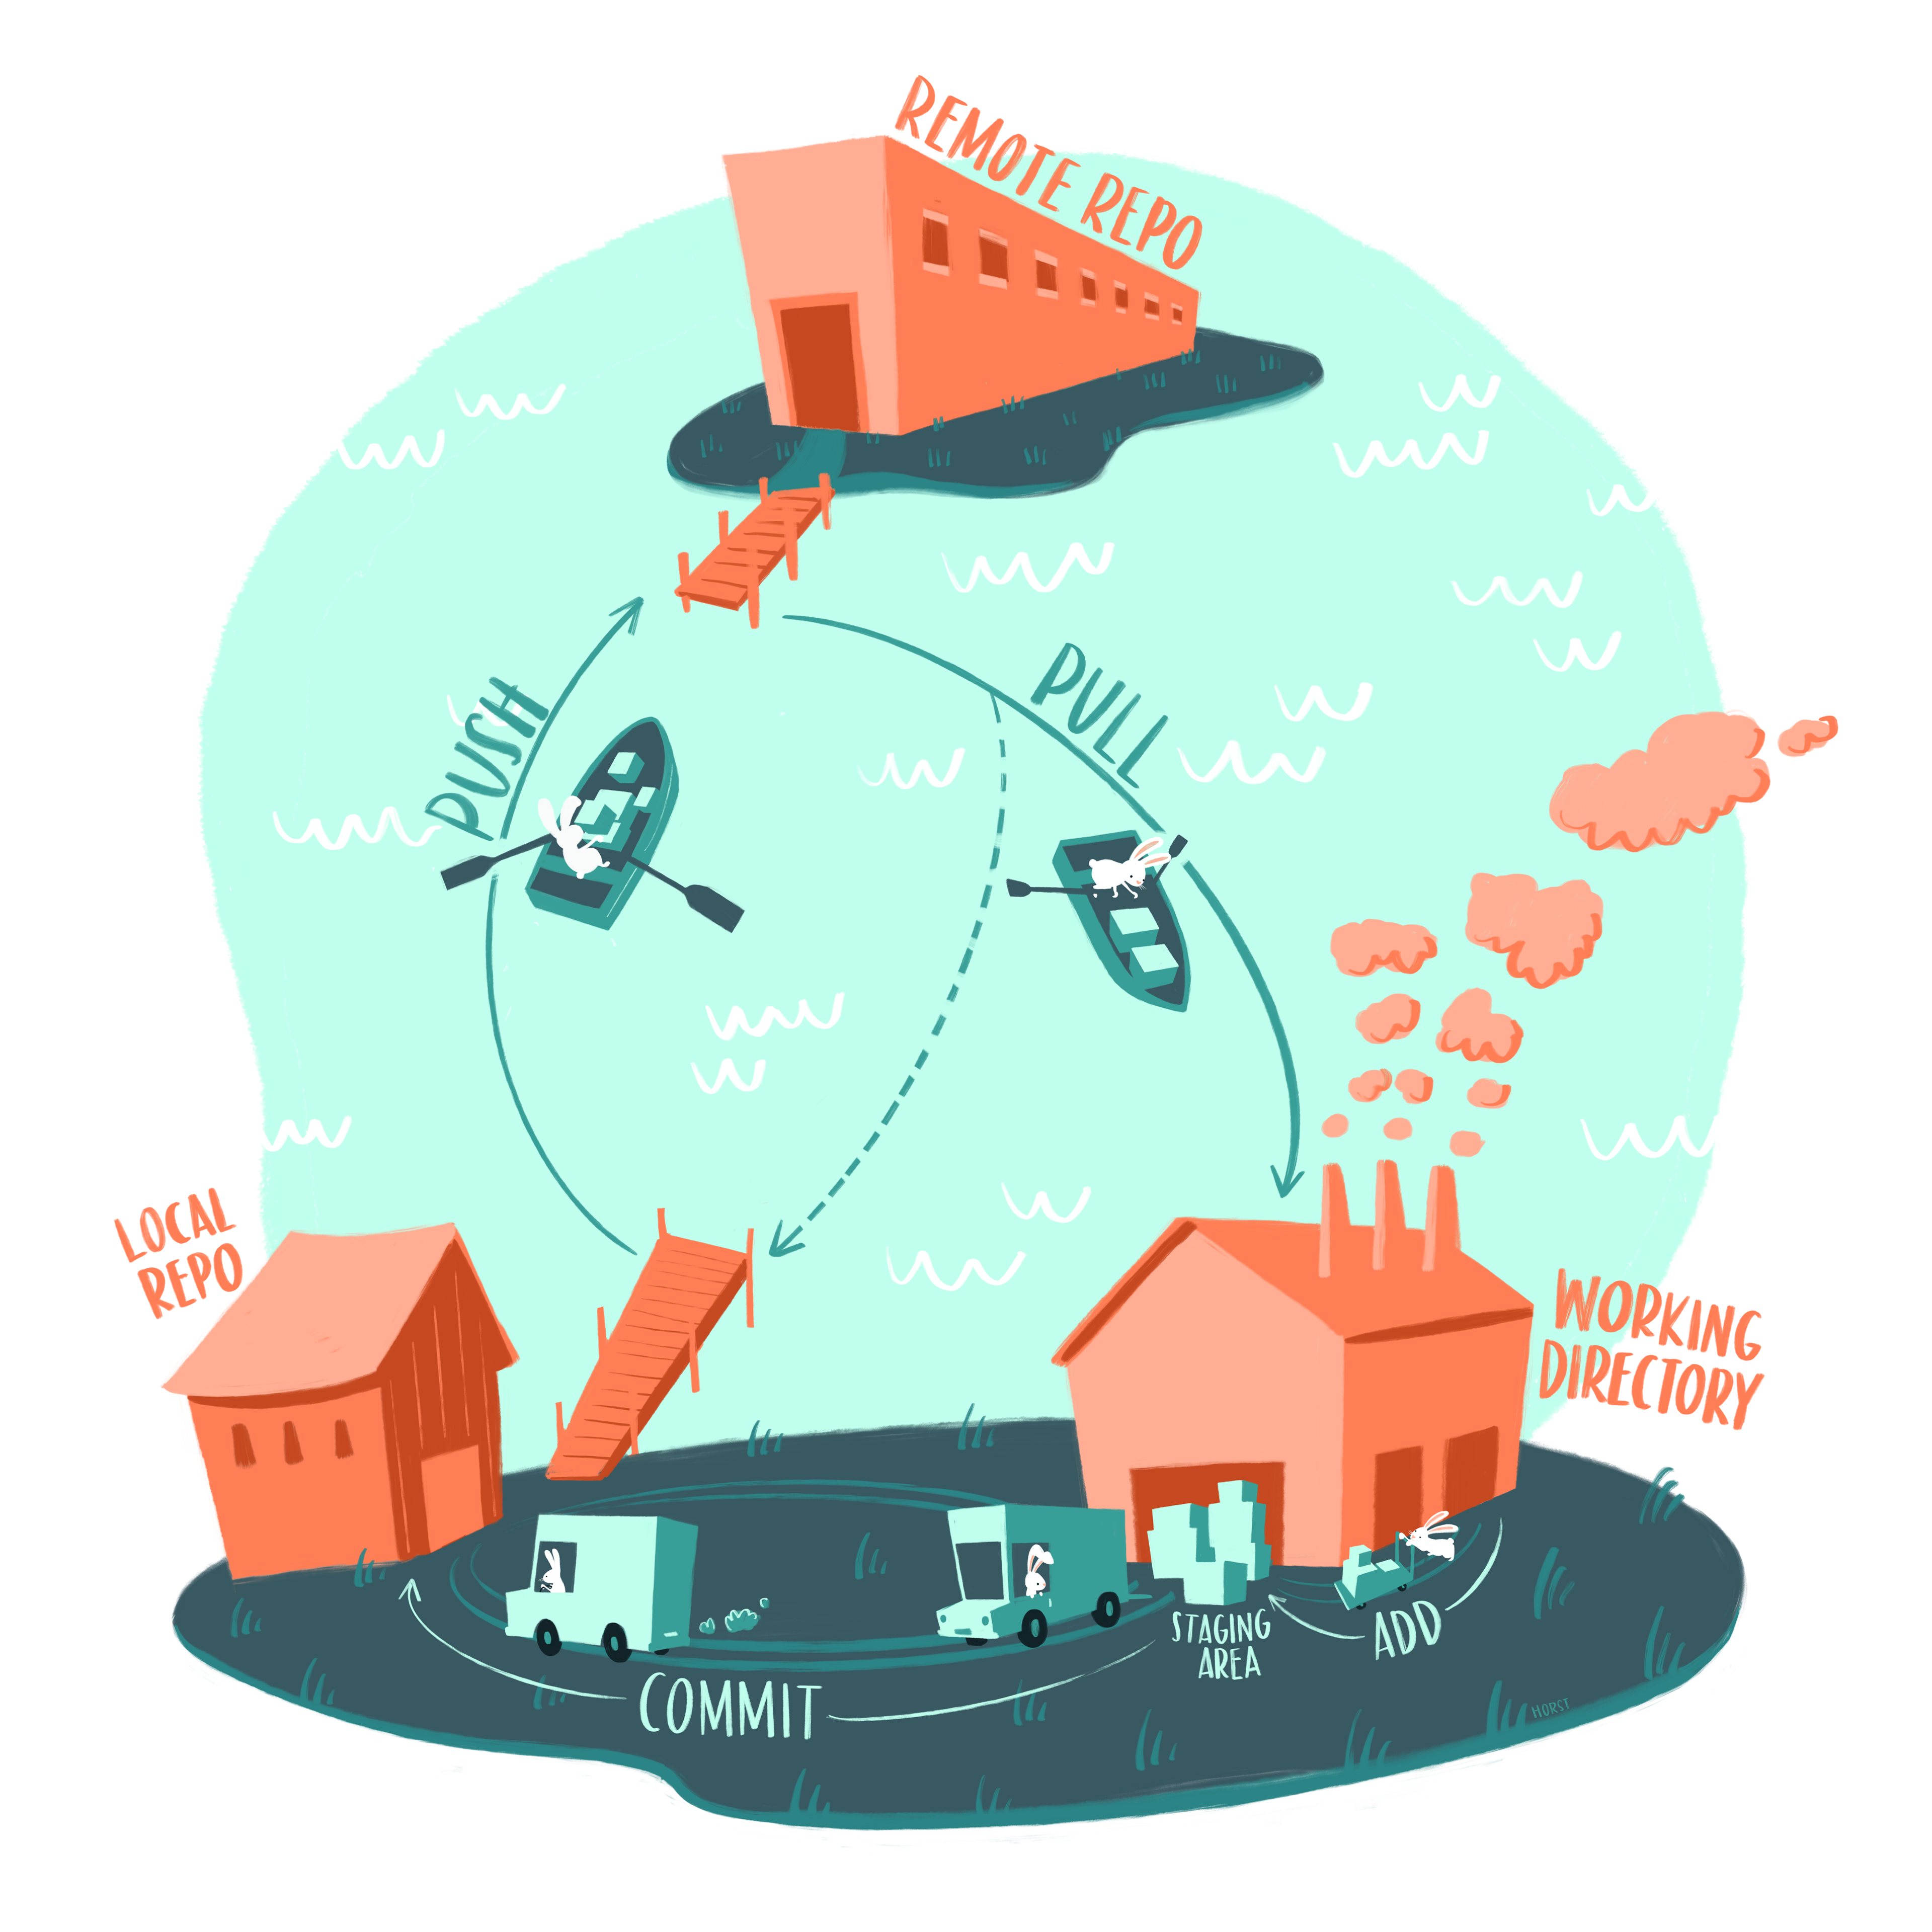
Basic github architecture

Slide 12

Key Concept: Branches
All commits live on a branch, which can be thought of as “versions” of your repository
There can be many different branches
The main branch in any project is the master branch

Slide 13
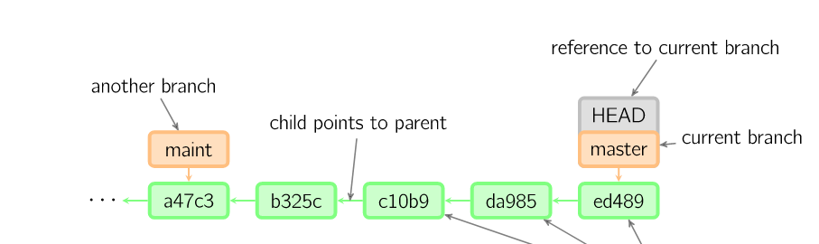
What does a branch look like?
HEAD is a reference to the most recent commit
master is the main branch in your project
Time

Slide 14
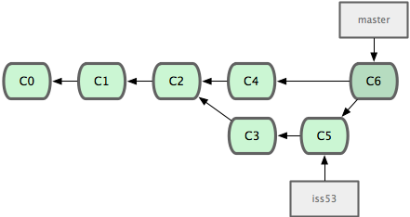
How do you branch from master?
The start of each branch points to a particular commit
When you want to make a new feature, make a new branch based on a commit
Feature-branch workflow
Time

Slide 15
How do you branch from master?
Make a new (local) branch and switch to it: git checkout -b <branch>
Switch to existing branch: git checkout <branch>
Create new remote branch when pushing changes: git push -u origin <branch>
Time

Slide 16
Key Concept: Merging
Once you’re done with your feature, you can merge your branch back into master
If someone else has made changes, will have to merge (can lead to merge conflicts)
Time

Slide 17
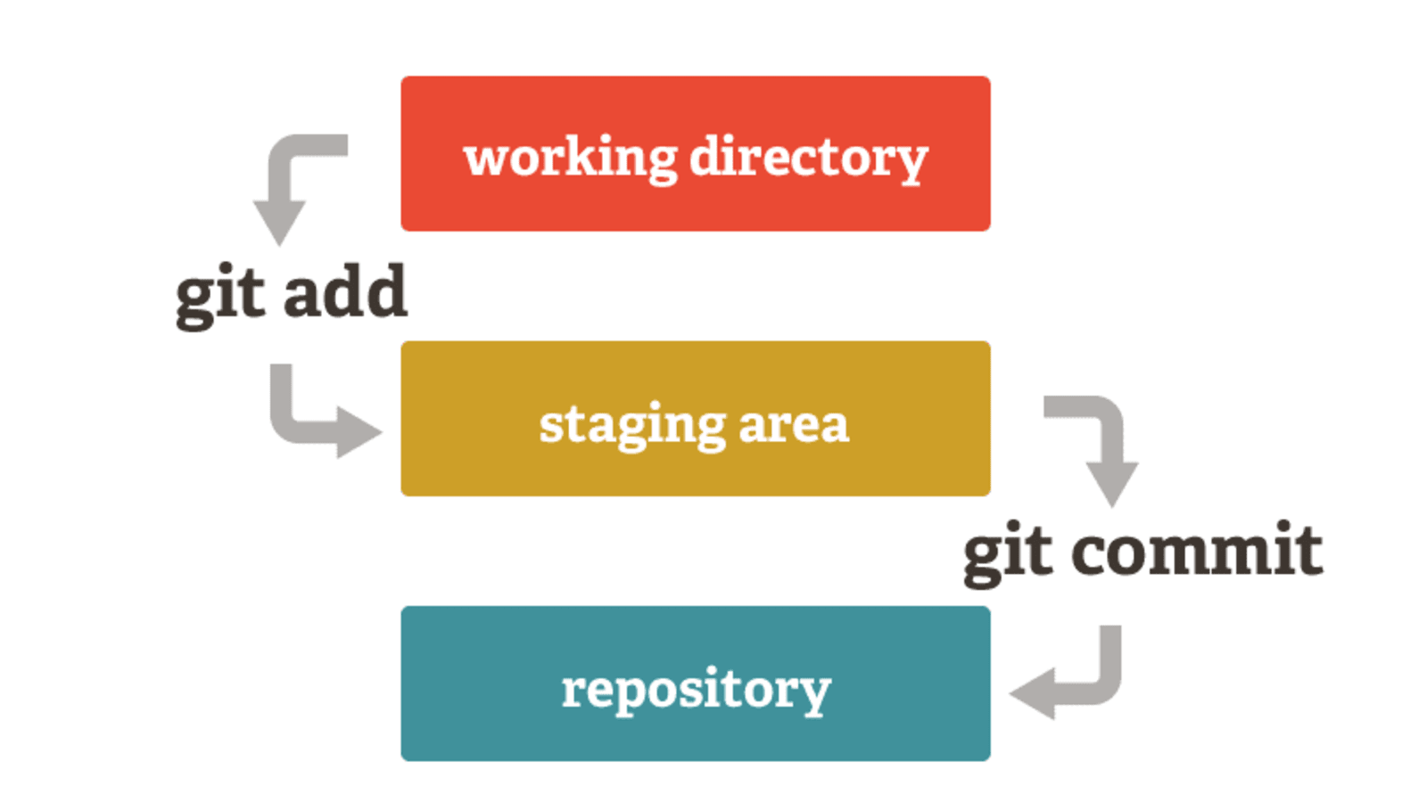
How do you make a commit?
Different “stages” that a file can be in
Local files on your computer: “the working directory”
When a file is ready to be committed, you put it in the “staging area”
Stage a commit

Slide 18
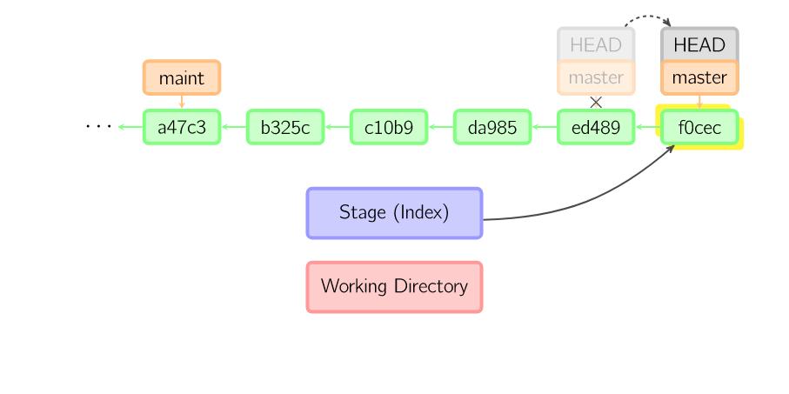
Adding a Commit
git add <filename> or git add .
Put file(s) in staging area
git commit -m “Your commit message here” or git commit
Message describing this commit
Without the -m flag, opens a text editor where you can write your commit message
Useful if you want to write a long description

Slide 19
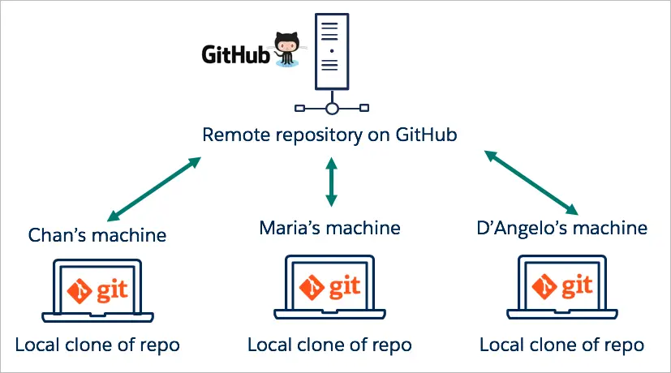
The Remote Repository
On GitHub (usually)
git pull
Pull changes from remote repository (e.g. from other users)
git push
Add your changes to the remote repository
Make sure you pull all changes before you try to push!

Slide 20
Key github commands
git push
Saving changes to Github in a specific branch
git status
Describes what changes have been made and needs to be committed to branch
git merge main
Updating local branch to reflect the changes made to the main branch
git reset –hard
Getting rid of all changes made
git pull
Updating code to be the same as the main branch
git checkout main
Going back to main branch
git checkout -b “BranchName”
Creating new branch that stems from main branch to make local changes
git commit -a -m “Description of Changes Made”
Saving all changes made up until that point

Slide 21
Practically: what you can do from RStudio
A lot of IDEs make it really easy to use github, because they hide command line code from you
This can be good or bad. I like it lol
When in doubt, run git status in terminal
https://docs.posit.co/ide/user/ide/guide/tools/version-control.html
Connecting R and github: https://happygitwithr.com/
Specifically chapters 10-12

Slide 22
Basic workflow
5
1
Pull from main
Create a new branch to do work on
Make your changes
Stage + Commit your changes
Create a pull request in Github for your changes
Merge branch with main
Close branch
6
2,3
4
Can commit multiple times
from working directory before
Merging branch with main

